Slide 1

Banner Health Evaluation
By: Kevin Nguyen, Denise Alvarez, Sandra Ochoa, Sarah Gavaldon
Photo from: banner health - Google Search. (n.d.). Www.google.com. Retrieved December 8, 2023, from https://www.google.com/search?sca_esv=588873340&q=banner+health&tbm=isch&source=lnms&sa=X&sqi=2&ved=2ahUKEwiKu5mv3v6CAxXWhe4BHcLrDSQQ0pQJegQIDBAB&biw=692&bih=715&dpr=2#imgrc=E0M3hQvwuaOXlM
‌

Slide 2
Banner Health's Mission, Vision, Values, and Geographic Areas
Mission
  "As the leading nonprofit provider of health care in every community we serve, Banner Health is deeply committed to our mission: Making health car easier, so life can be better" (BHF).
Vision
  "We will be a national leader recognized for clinical excellence and innovation, preferred for a highly coordinated patient experience, and distinguished by the quality of our people" (BHF).
Values
  "People above all... by treating those we serve and each other with compassion, dignity and respect.
  Excellence... by acting with integrity and striving for the highest quality care and service
  Results... by exceeding the expectations of the people we serve and those we set for ourselves" (BHF)
Geographic areas Banner serves
  Thirty acute-care hospitals + many other health care entities and teaching hospitals (BHF)
  Banner is in six states: Arizona, California, Colorado, Nebraska, Nevada and Wyoming (BHF)
  Headquarters address: 2901 North Central Ave., Phoenix, Arizona 85012 (BHF)

Slide 3

Types of Services That Banner Provides
Geriatrics
Gynecology
Healthy Aging
Heart
Home Care
Hospice
Imaging
Infectious Disease
Infusion Therapy
Injury Prevention
Integrative Therapy
Intensive Care
Internal Medicine
Kidney
Lab
Maternity
Medical Imaging
Neonatology
Neurology
Neurosurgery
Nutrition
Obstetrics
Occupational Health
Orthopedics
Academic Medicine
Allergy & Immunology
Alzheimer's Disease & Dementia
Asthma
Audiology
Banner Brain & Spine
Bariatric & Weight Loss Surgery
Behavioral & Mental Health
Burn Care
Cancer
Concierge Medicine
Concussion
Critical Care Medicine
Dermatology
Diabetes
Doctors & Specialists
Ear, Nose & Throat
Emergency
Endocrinology
Endoscopy
Eye Care
Family Medicine
Gastroenterology
Outpatient Surgery
Pain Management
Palliative Care
Pediatrics
Pharmacy
Physical Therapy
Poison & Drug Information Center
Primary Care
Psychology
Pulmonary
Rehabilitation
Research
Spine
Sleep Medicine
Sports Medicine
Surgery
Telehealth
Transplant
Urgent Care
Urology
Volunteer
Wellness
Women’s Health
Wound Care
Photo from: banner health - Google Search. (n.d.). Www.google.com. Retrieved December 8, 2023, from https://www.google.com/search?sca_esv=588873340&q=banner+health&tbm=isch&source=lnms&sa=X&sqi=2&ved=2ahUKEwjbxZ_f7_6CAxXXMUQIHeBcCSQQ0pQJegQICxAB&biw=1440&bih=813&dpr=2#imgrc=ZhET2d0b6IRBVM
‌
Service list from: Our Services Listing | Banner Health. (n.d.). Www.bannerhealth.com. Retrieved December 8, 2023, from https://www.bannerhealth.com/services/service-listing
‌

Slide 4

Banner Health's readiness to improve care outcomes
In every area that Banner Health serves, it is well-prepared for changes due to its steady growth and effective leadership. The organization's readiness for change is evaluated by assessing leadership quality, available resources, and staff's willingness to learn and adapt.
Banner Health is ever-evolving, the organization has steadily expanded its network over the past decade, indicating adaptability and a quick approach to meeting evolving healthcare needs.
The leadership philosophy, as said by CEO Peter Fine, "visibility breeds trust, authority breeds trust, and if you want to be trusted, you better be visible” emphasizes visibility, trust-building, and a willingness to make difficult decisions. These attributes are positive to fostering an atmosphere of accountability and continuous improvement in care delivery.
We believe that Banner Health's readiness to improve care outcomes seems promising, given its strategic planning, leadership philosophy, workforce expansion, and etc. All these things together make Banner Health ready to handle changes and keep improving the care they give to patients.
Health Recovery Solutions. (2023, September 28). How to improve population health management with RPM. HRS. https://www.healthrecoverysolutions.com/blog/how-to-improve-population-health-management-with-rpm

Slide 5
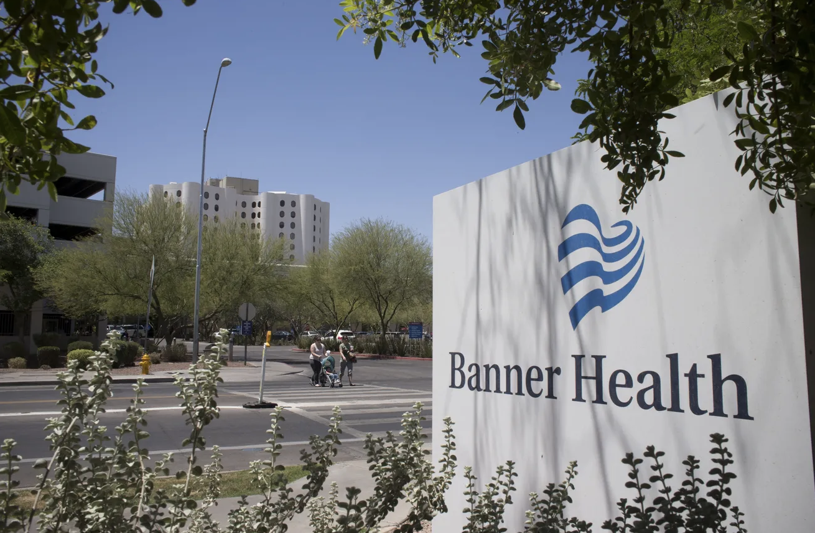
Banner Health as a Health Care Organization
Banner Health's headquarters is in Phoenix and it "is one of the largest, nonprofit health care systems in the country" (BHF).
Banner serves its patients as opposed to generate profit off them
Any money that Banner earns goes into "new hospital beds, new or expanding patient care services, new physician services, new technologies, maintaining existing equipment and facilities, and paying employees’ salaries" (BHF).
"With more than 1 million members currently served by the Banner Health's provider networks, Banner has demonstrated the ability to effectively manage the health and wellness of populations of insured members in both government and private plans" (BHF)
Community aspect: "We provide $122 million in charity care. Unpaid cost of public programs, Medicaid and other programs for those uninsured - $380 million. Health professional education - $103 million. Research activities - $17 million. Total cost of the community benefit and the unpaid cost of Medicare - $890 million" (BHF)
Photo from: Innes, S. (2021). Banner Health is requiring employees to get the COVID-19 vaccine by Nov. 1. The Arizona Republic.https://www.azcentral.com/story/news/local/arizona-health/2021/07/20/banner-health-requiring-covid-19-vaccine-employees/8031756002/
‌

Slide 6
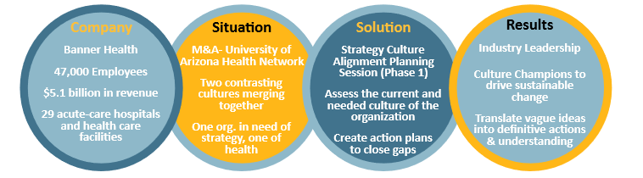
Banner Health’s Strategic Plan
Recently in 2022, Banner Health conducted a Community Health Needs Assessment (CHNA) and identified significant health needs.
In response to this Banner developed systemwide strategies to address these needs.
  The strategies include improving community health, supporting team members through wellness programs, aligning strategies with Social Determinants of Health (SDOH) practices, addressing specific health needs like chronic disease management, cancer screenings, behavioral health, and etc (Banner Health, 2022).
Each one of these strategies, there are specific actions and expected results. The main goals are to make healthcare more accessible, increase awareness, and offer support in different healthcare settings.
Work Effects. (2018, December 20). Banner health. https://work-effects.com/banner-health/
The overall goal is to enhance community well-being by implementing targeted healthcare interventions and support systems.

Slide 7

How Does Banner Address Issues Pertaining to Network Growth and Nurse Staffing?
As part of Banner Health’s strategic plan which focuses on meeting citizen’s healthcare needs in the next decade. The organization has been acquiring healthcare facilities to expand its network.
The organization aims to respond to the rising healthcare needs of an aging population by establishing new facilities and ensuring accessibility to effective, affordable medical care.
Healthcare workers are always pursuing ever-learning education to learn and adapt to technologies that will be implemented in the healthcare industry.
Staffing strategies prioritize mandated nurse and physician ratios to prevent burnout, with support from interprofessional training programs keeping healthcare workers updated on evidence-based practices and technologies.
Himanshu JainComing from an IT background of SAP consulting. (n.d.). Networking for personal and professional growth. ReachExt K.K. https://www.reachext.co.jp/career-advice/networking-for-personal-and-professional-growth

Slide 8

How Does Banner Addresses Issues Pertaining to Resource Management and Patient Satisfaction?
Banner Health’s strategic plan focuses on patient satisfaction by establishing new facilities to respond to the increasing healthcare needs of the population.
Banner Health recognizes the important of staffing ratios. By mandating practical patient-to-nurse ratios it allows nurses to not be burnt out and provide ensured quality care to their patients, which in return improves their satisfaction.
Banner Health allocates their resources effectively to meet the evolving healthcare needs of the population
  They do this by investing in training programs for healthcare professionals, ensuring that they are equipped with the latest skills and knowledge. This not only enhances the quality of patient care but also contributes to the overall readiness of the organization to adapt to new challenges.
  And a focus on effective human resource management, which includes recruitment, training, and retention of skilled healthcare professionals. Especially, the organization's emphasis on maintaining practical staffing ratios that prevents burnout and contributes to positive patient outcomes.

Slide 9

Shared Governance:
Defines a team leadership structure which promotes open dialogue between all members to create a shared vision. This results in completely sharing the making and execution of decisions.
Key Shared Governance Behaviors:
Respect all Opinions
Consider all Feedback
Decisions made with appropriate representation
Shared Decisions incorporate:
Shared Accountability
Engagement
Encourage empowerment of staff
Foster trust

Slide 10

Interprofessional Collaboration:
Nurses and other healthcare professionals, with different backgrounds, cultures and values, work together to meet complex healthcare challenges.
Inclusion of Different Roles:
professionals with different healthcare disciplines such as doctors, nurses, therapists
Management
Inside/Outside Stakeholders
Key Interprofessional behaviors to assure proper collaboration:
Communication
Respect
Altruism
Excellence
Ethics
Accountability
Diverse Backgrounds Incorporate different:
Disciplines and expertise
Cultures
Adaptability
Ethics

Slide 11

Organizational Culture and Values
Culture and values are mutually established through shared governance of Interprofessional collaboration, which shape ideal beliefs, values and norms within the organization.
Active participation of a diverse team allows everyone a voice, in which everyone learns and everyone teaches something. Consequently this committee can cultivate organizational beliefs and values such as communication, integrity, beneficence, justice and respect.
Benefits of Interprofessional collaboration and shared governance:
Patient Safety Culture
  reduce rate of complications & errors
  reduce length of stay
  reduce mortality rate
Positive Employee Environment Culture
  reducing conflict among staff
  reducing staff turnover

Slide 12
Lewin's Change Management Theory
Lewin's change management theory uses three different stages in order to establish change in an organization
Unfreezing
  In this stage the organization finds out what is wrong with the organization by looking for processes that need change and where inefficiencies occur. Gaining the support of management and seeing employee points of view is part of this step. The unfreezing allows for the change in organization to be made.
Change
  In this stage the change that is wanted occurs. A change in process can be difficult if not handled correctly. In this portion of the change model, communication, education and support is crucial. It helps to reduce tension
Refreeze
  In this portion of the mode, refreezing takes place. This is where the change wanted is set to be the new normal. In order for the refreezing stage to be effective, continuous evaluation of the process needs to be made as well as constat recognition for employees. T

Slide 13

Lewin's Change Management Theory and Banner Health's Plan
Banner Health wants to implement new changes to make healthcare more accessible, increase awareness and offering support in different settings. Banner Health can use the Lewing Change Management Theory in order to establish the changes they want to make.
In their unfreezing stage, the organization has seen different ways of achieving their goals by creating strategies as stated like improving community health and targeting different ways to make people aware of their health needs while also making healthcare accessible
Banner Health has implemented the change state in that they have made ways for staff to become supportive such as creating better staffing ratios and creating more facilities to meet the population needs among other plans.
He refreezing stage would just involve in the organization to reevaluate in the effectiveness of said changes and to recognize staff so that the the changes mad are effective.

Slide 14
Why would the Lewin's Change Management Theory work the best?
The Lewin's Change Management Theory would work the best in that Banner Health wants to create several changes to improve healthcare and maintain their mission of making healthcare easier so that life could be better. The three stages of Lewin's theory involve planning on process changes, educating staff and creating environments that decrease staff tension.
This model is a practical way of implementing new ideas in a way that doesn’t involve many steps. This theory also uses the use of positive reinforcements to continue the changes made .

Slide 15
References
Agency for Healthcare Research and Quality. (2022). What Is Patient Safety Culture? | Agency for Healthcare Research and Quality. Www.ahrq.gov.
  https://www.ahrq.gov/sops/about/patient-safety-culture.html
Banner Health. (2021, February). Banner Health at a Glance. Www.bannerhealth.com. https://www.bannerhealth.com/about/glance
Helbig, J., & Thomas, J.S., & Whitney, S. (2022) Nursing Leadership and Management . (3rd ed). Grand Canyon University.BibliU - Reader - Nursing Leadership
  and Management: Leading and Serving
Lindsay, M. (2023). A shared governance approach to nursing documentation redesign using Kotter's change management model. Nursing Management
  (Springhouse), 54 (3), 14-20. doi: 10.1097/01.NUMA.0000919064.29246.6b
Mission & Vision : Banner Health Foundation. (n.d.). Www.bannerhealthfoundation.org. Retrieved December 8, 2023, from
  https://www.bannerhealthfoundation.org/about/mission-and-vision#:~:text=Headquartered%20in%20Phoenix%2C%20Arizona%2C%20Banner
Murphy, J. (2020). Interprofessional Collaboration | Transitions to Professional Nursing Practice. Courses.lumenlearning.com.
  https://courses.lumenlearning.com/suny-delhi-professionalnursing/chapter/interprofessional-collaboration/
‌Our Services Listing | Banner Health. (n.d.). Www.bannerhealth.com. Retrieved December 8, 2023, from https://www.bannerhealth.com/services/service-listing
2022 community health needs assessment: Final implementation strategies. (n.d.-a). https://www.bannerhealth.com/-/media/files/project/bh/chna-
  reports/2022/implementation-strategies-for-posting.ashx

